Slide 1







April 20th, 2021
PM: Hunter
Frontend: Neha, Christian, Jody, Saptarshi
Backend: Hunter, Ethan, Steven, Dani
Notes:
Presenter: Hunter
Hello everyone! We are Poll Buddy. I’m Hunter, the project manager, and I’m going to start us off by giving an overview of our app and how we’re developing it, and later you’ll hear from the other Poll Buddies some in depth details about the different portions of the project.

Slide 2
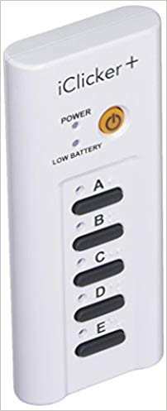
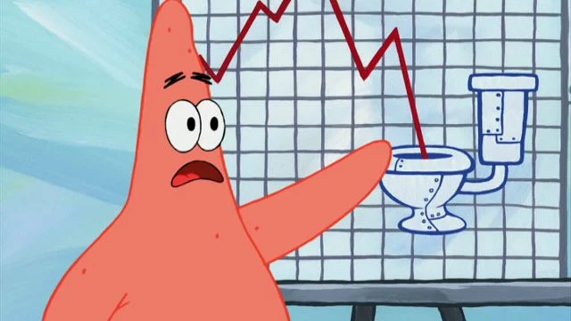
What is Poll Buddy?
Website alternative to iClickers
Virtual polling system
Affordable, easy to use, and interactive
Powerful views for everyone
Integratable with RPI platforms like CAS
Notes:
Presenter: Hunter
So jumping right in, what is Poll Buddy? As a quick overview, Poll Buddy is a website alternative to iClickers. iClickers are classroom tools used to get responses from students, but they have some major limitations. We’re building a virtual polling system that’s affordable, easy to use, and interactive for everyone. We also are now integrated with RPI’s CAS login system, and hope to add other integrations like Submitty in the future.

Slide 3
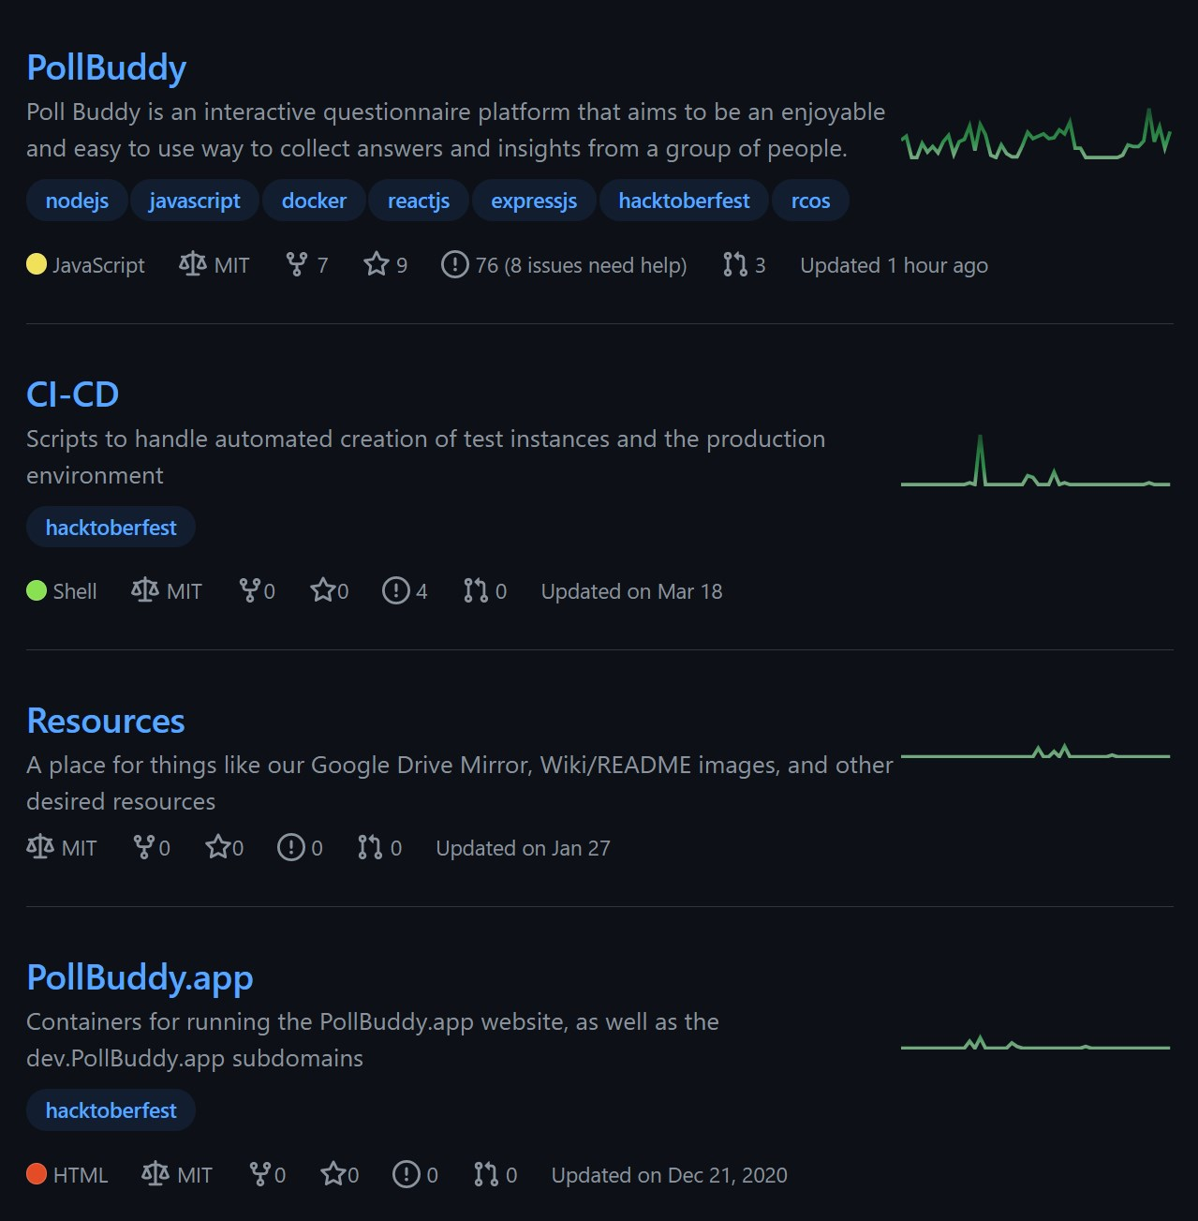
Poll Buddy Info
Time Goal of the Project: Demo now!
Public Beta Product: End of Summer 2021
Repos: https://github.com/PollBuddy
Licenses: MIT
Contributors: Anyone can access the repos.
Poll Buddy members can work directly with the repo through branches and pull requests. Outside contributors can fork and PR.
Github issue list gives potential tasks to work on. We also now have a Contribution Guide and Wiki with ever expanding documentation.
Notes:
Presenter: Hunter
We’ve been working on Poll Buddy for 5 semesters now (which is hard to believe, time flies), and now we would like to do our second live demo! More on that later. We’re hoping to do beta testing in RCOS at the end of the summer (similar to how Venue is being used now), and use feedback from that to finish preparations for a wider rollout. We’ve made a ton of progress over the semesters and everything has been coming together nicely.
On this slide, I’ve linked our Github Organization page that contains the 4 repos we now have, as well as their licenses. As for contributors, everything is open source and we have a wiki with a contribution guide and other information about the app to aid in development and understanding how things work.

Slide 4
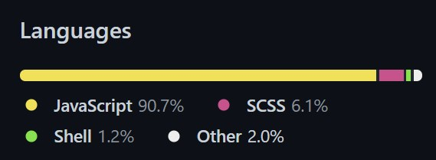
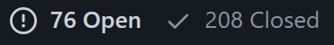
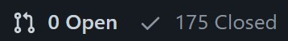
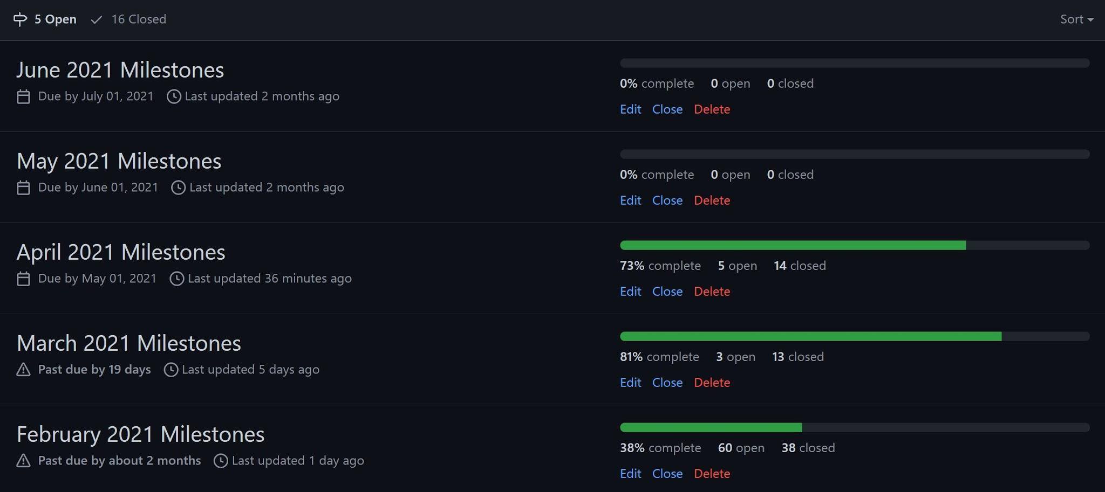
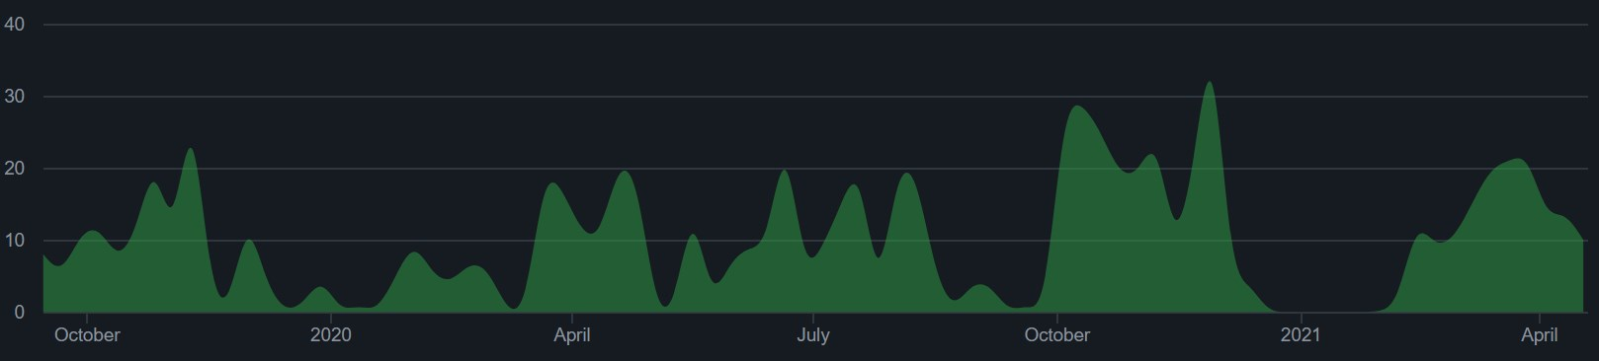
Managing the Project
Milestones were broken down into months and issues per month.
Issues used as trackers for todo items. Labeled frontend / backend / other tags as relevant.
1204 total commits to master (as of 4/20/2021)
Contributions to master, excluding merge commits:
Notes:
Presenter: Hunter
We track to-do items through Github Issues, and link them to monthly milestones to try to keep on a schedule. We do our best to stick to the milestones, but as you can see from the bottom right, they end up being more of suggestions as to what to do soonest rather than rigid guidelines. I’ve also included some assorted stats about the main repo, such as that we’ve added about 300 commits to the repos this semester, bringing us up to about 1200, as well as some figures about our total number of issues and pull requests on the right, language usage breakdown at the top, and monthly commit amounts at the bottom left.

Slide 5
Demo
You can try out Poll Buddy right now!
Try out a poll! https://pollbuddy.app/polls/607e502721601577468b4ba8/view
Other pages and features you’ll see in later slides are live and you can check them out with links on each slide!
Notes:
Presenter: Hunter
And lastly before we get into the frontend and backend details, we’ve got our demo! Visit the link you see on the slide (or posted in the Webex chat) and you can try out a real poll! After this slide, we’ll start getting into some individual contributions and many of those will also have live page links that you can also visit and see for yourself if you’d like. The slides have been posted in the RCOS slides channel as well for easy link clicking. Be warned though that there’s a lot of parts of the website that are still a work in progress, so you’ll probably run into something that doesn’t work right if you go poking around, but you shouldn’t be able to break anything at least, so have fun.

Slide 6
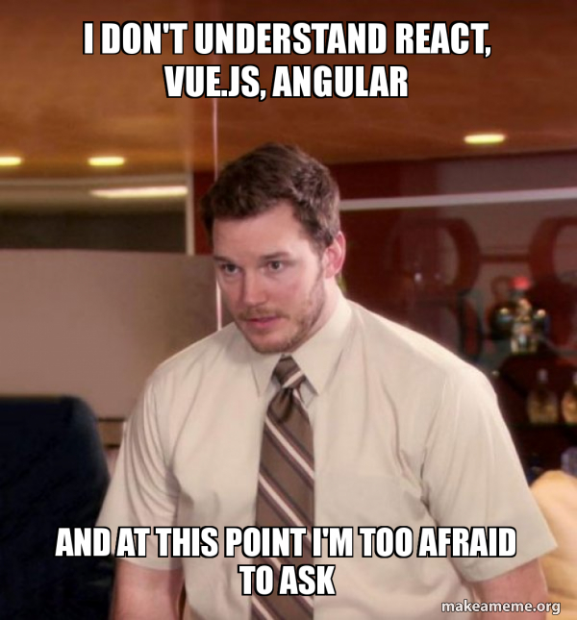


Front End
Notes:
Hunter: That’s all for me, now I’ll pass it off to Neha to talk about the frontend.
Presenter: Neha
Hi I’m Neha and I’ll be going over the frontend part of the app. We use React.js as the framework for Poll Buddy because it allows for efficient code reuse with components. We also use React Bootstrap for a library of pre-made design components.

Slide 7
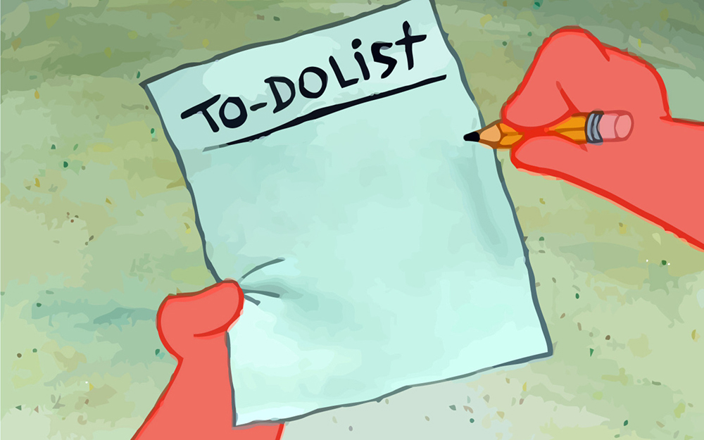
Frontend Tasks
Completed:
Login system integration
Dynamic functionality for many pages
Refined page styling
Code and page cleanups
Poll Editor component
In Progress:
Backend integration
Early testing
Poll
Buddy
Take over
Change the world
Notes:
Presenter: Neha
We’ve made quite some progress this semester in order to reach our goals from the proposal, mostly the things you can see on this slide. We still have some things we need to do during the rest of the semester, but we’ve made a lot of progress until now.

Slide 8
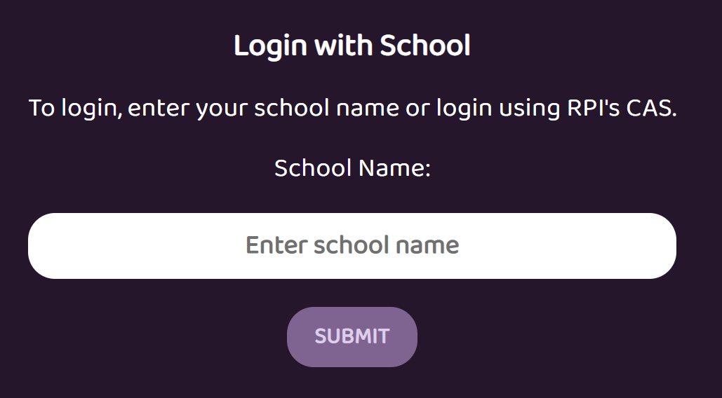
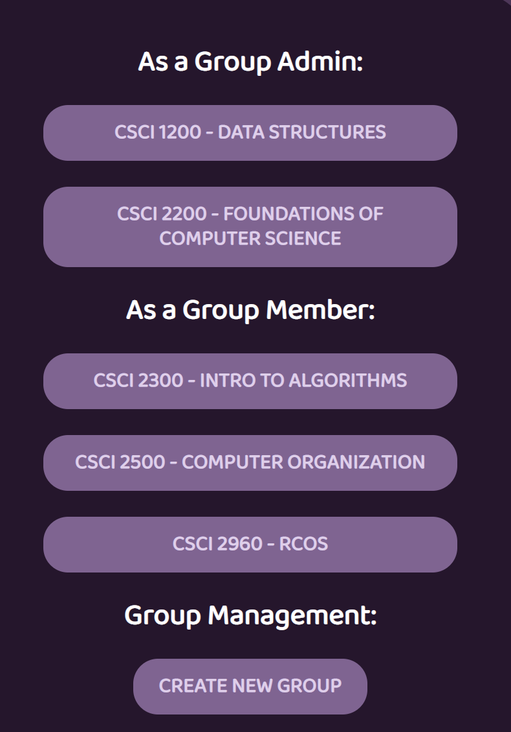
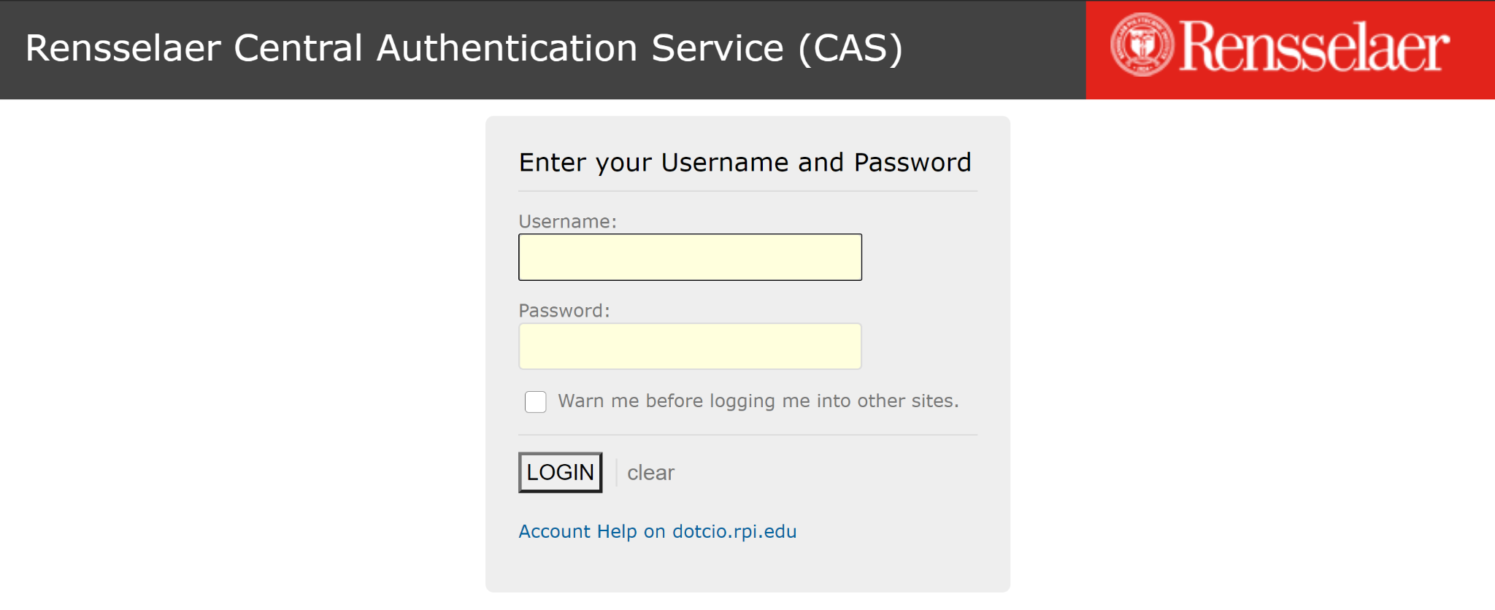
Frontend Login System
https://pollbuddy.app/login/school
Notes:
Presenter: Neha
Personally, this semester I worked on implementing the login system into the frontend. Hunter will talk about the backend part of the login system later on in the presentation. What happens for this system is first you have to register for an account, so select RPI for the school name, then the website redirects you to the RPI CAS page. It’s also the same procedure for logging in, and it redirects you to the groups page. What I did was getting user data from the backend API URLs including the user’s name, email, and username and store that information locally in the frontend so that it can be used for other pages. I also did a lot of error checking to make sure the whole process works properly.

Slide 9
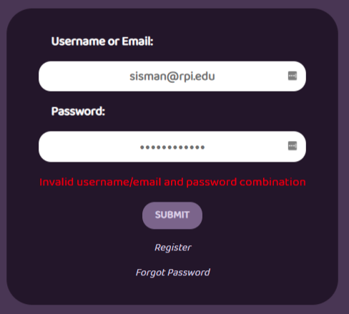
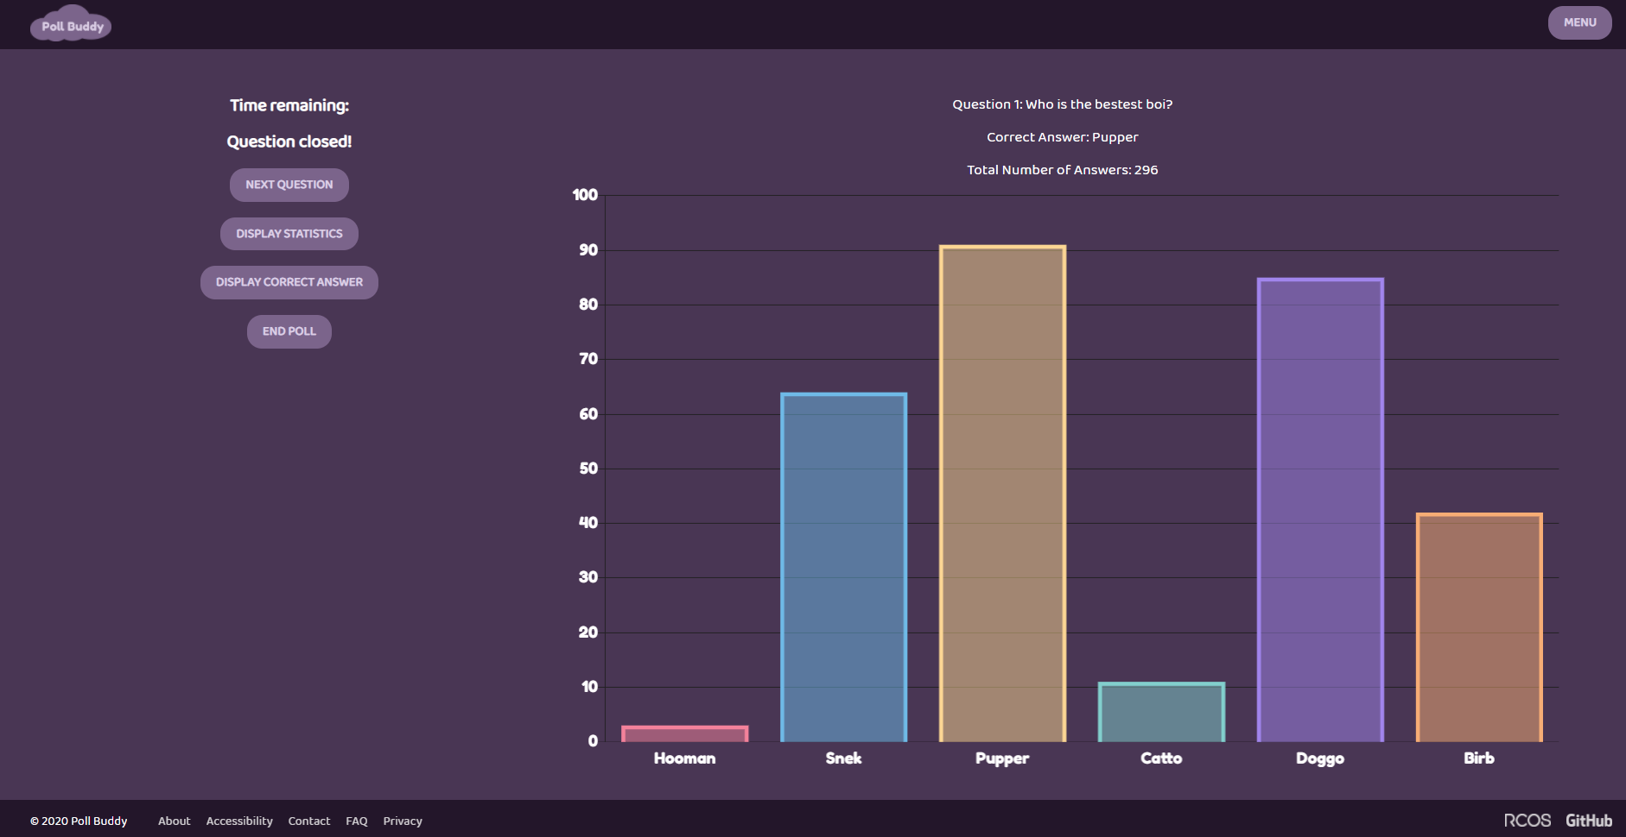
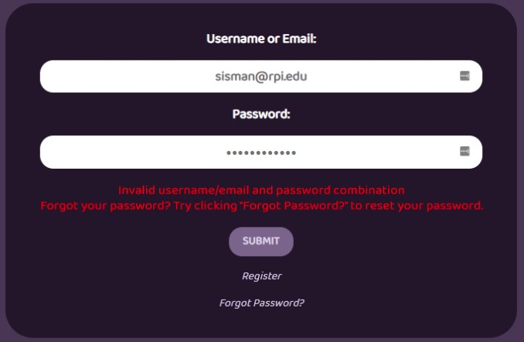
Various Frontend Touch-ups
Notes:
Presenter: Christian
Hi, my name is Christian, and I’ve spent my time working on various frontend changes. I revived an old frontend branch with the up-to-date one we have now to find any salvageable code. I also updated part of the login system, where after a certain amount of failed attempts, the user gets an additional message to remind them of our Forgot Password link.

Slide 10
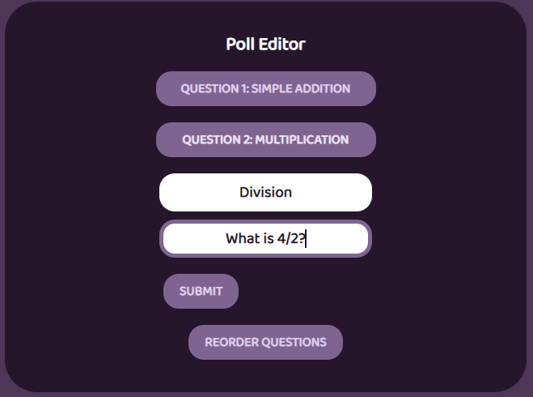
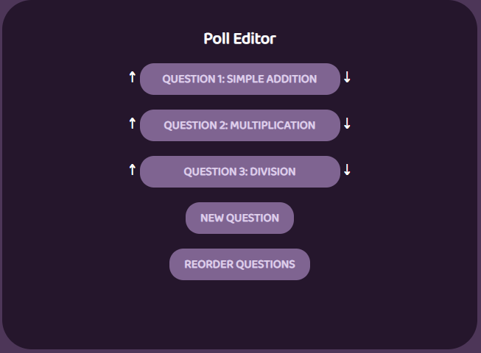
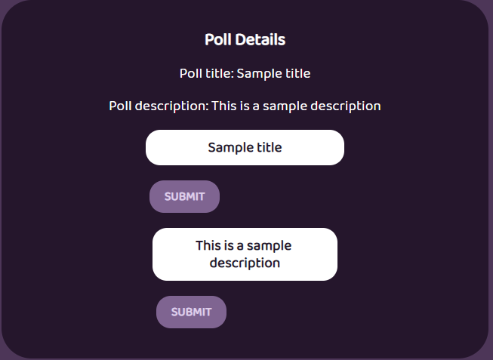
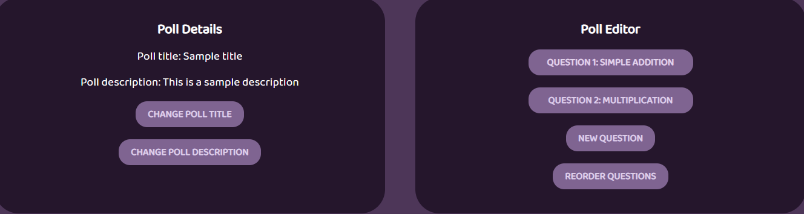
Poll Editor Page
Edit title and description
Question editor
New question button
Reorder questions
https://pollbuddy.app/polls/1/edit
Notes:
Presenter: Jody
Hello, I’m Jody, and this semester I worked on a number of different frontend related tasks, but I spent a majority of my time working on the Poll Editor page. This page is organized into two distinct content boxes; the one on the left is for Poll Details, where users can view their poll title and description as well as edit them. The content box on the right is the Poll Question Editor. Users are presented with a list of their current poll questions, and they can add new ones by clicking the New Question button. Users can also edit a question by clicking it to reveal a question editor form. Additionally, the user can change the order of the questions by clicking the Reorder Questions button. When they click this button, up and down arrows appear adjacent to each of the questions, and the user can easily change the order by clicking the arrows.

Slide 11
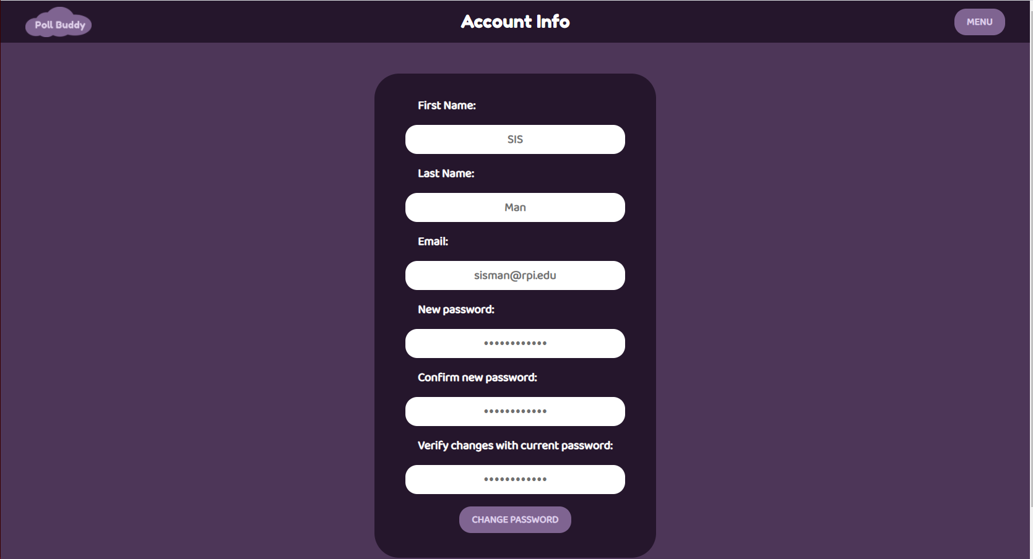
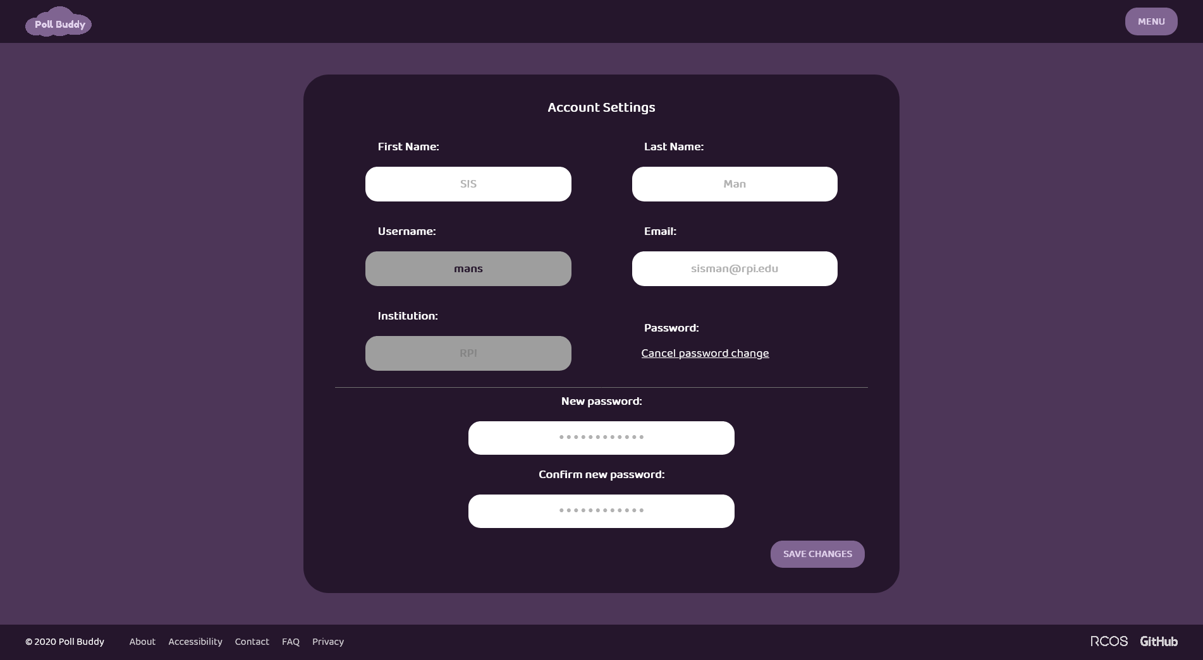
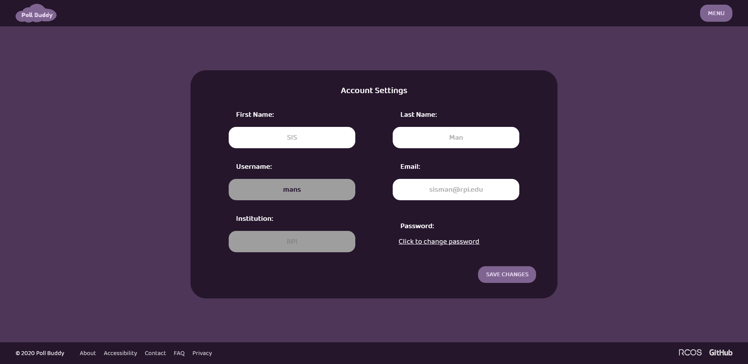
Account Info Page
Notes:
Presenter: Saptarshi
I’m sappy and I worked on a mix of frontend and backend issues but my main contributions went towards restyling the Account Info page. This page is now space optimized while maintaining mobile friendliness, the immutable fields are greyed out and outlined in red on focus, the change password fields have been hidden to the user unless they specifically click to change their password, and finally, the change password button has been replaced with a more general “Save Changes” button to indicate that more than just the password fields can be edited and saved.

Slide 12
Back End
Notes:
Presenter: Hunter
Hi again, I’m back to talk about the backend now.

Slide 13




Backend Technologies
Docker
NodeJS
Express
MongoDB
Notes:
Presenter: Hunter
As a brief overview, we’ve got several technologies used in the backend. We use Docker to package up and run the app simply and easily, NodeJS to run the JavaScript code we use, Express to make it easy to set up an API, and MongoDB to store all our long term data.

Slide 14
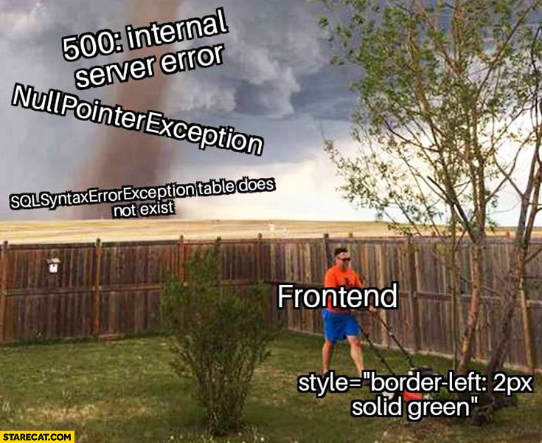
Backend Tasks
Backend Future Tasks
Further integration with frontend
API documentation
Additional endpoints for frontend features
Endpoint renovation, updating
Login functionality
Further frontend integration
Additional helpful functionality
Further logging/reporting capabilities and graphs
Submitty integration
Anti-cheating
And much more!
Notes:
Presenter: Hunter
Some of the goals this semester were to further the integration with frontend, add more documentation and functionality, finish the login and registration system functionality, and renovate some of the early endpoints so they match our current designs and needs.
As for our future goals, we aim to finish the frontend/backend integration, add more functionality on top of our core focus, add further logging and reporting abilities, add in integration with Submitty, anti-cheat functionality, and much more.

Slide 15
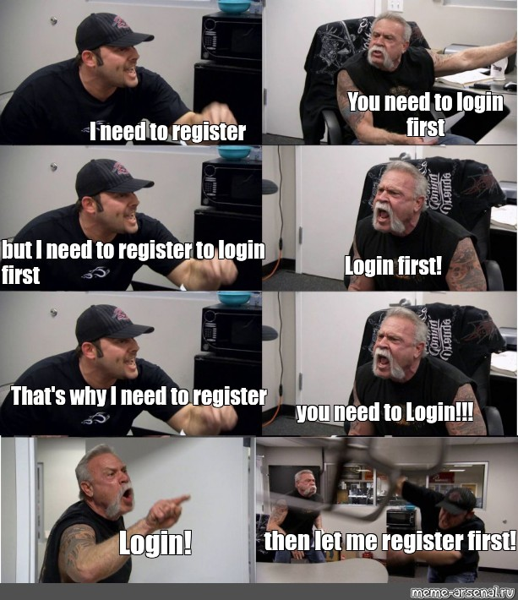
Login System
Can now handle both registration and login with both school and Poll Buddy accounts.
Extensive reworking of the system for flexibility and ease of use.
Every backend endpoint documented in the code and wiki.
Entire login/registration flow documented in the wiki
Session stores user’s ID for easy lookups, checks in the backend.
Logging in/Registering returns basic user information to the frontend
https://pollbuddy.app/register/
https://pollbuddy.app/login/
Notes:
Presenter: Hunter
A big focus for me this semester was getting the login system renovated and fully operational. If you haven’t already and would like to try it out, check out the links at the bottom of the slide. Getting this all to work consisted of extensive rethinking and planning out the registration and login flows, rebuilding all the endpoints needed and planning out the exact control and data flow to have everything available at the right time. I also made a ton of documentation for the whole process in the code and in our wiki so it’d be easy for frontend folks like Neha to take that and make the frontend portion work with the new system. At long last, everything finally works. This also enables us to add functionality like requiring a login to access certain pages, which we have been avoiding for the time being.

Slide 16

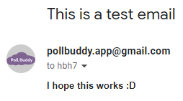
Email System
Created a Google account to use for now.
Code currently exists and works to send test emails.
Further work needed to finalize and make it easy for other parts of the app to send emails (such as for password resets).
Notes:
Presenter: Hunter
I also spent some time working on an automated emailing system. There’s still some work to do, but it does actually function which is pretty neat. What I’ve got so far is a Google account to use to send the emails from, and code to do so. You can see the address below, but in practice, that will get replaced with an address on the pollbuddy.app domain, I just haven’t gotten there yet. Google makes that easy to do this though so I don’t expect any problems there. That email screenshot was actually sent from the Poll Buddy backend, all using code and with no manual interaction, so it was certainly exciting when it arrived in my inbox. Using a Google account for something like this actually has a few benefits, such as the pretty high sending limits compared to other free offerings, the easy integration with a Node app, and the domain-based email support. I wouldn’t be surprised if it has to be replaced at some point due to volume of emails, but that should be a long way off, and a lot of the code would be reusable if that were to happen.

Slide 17
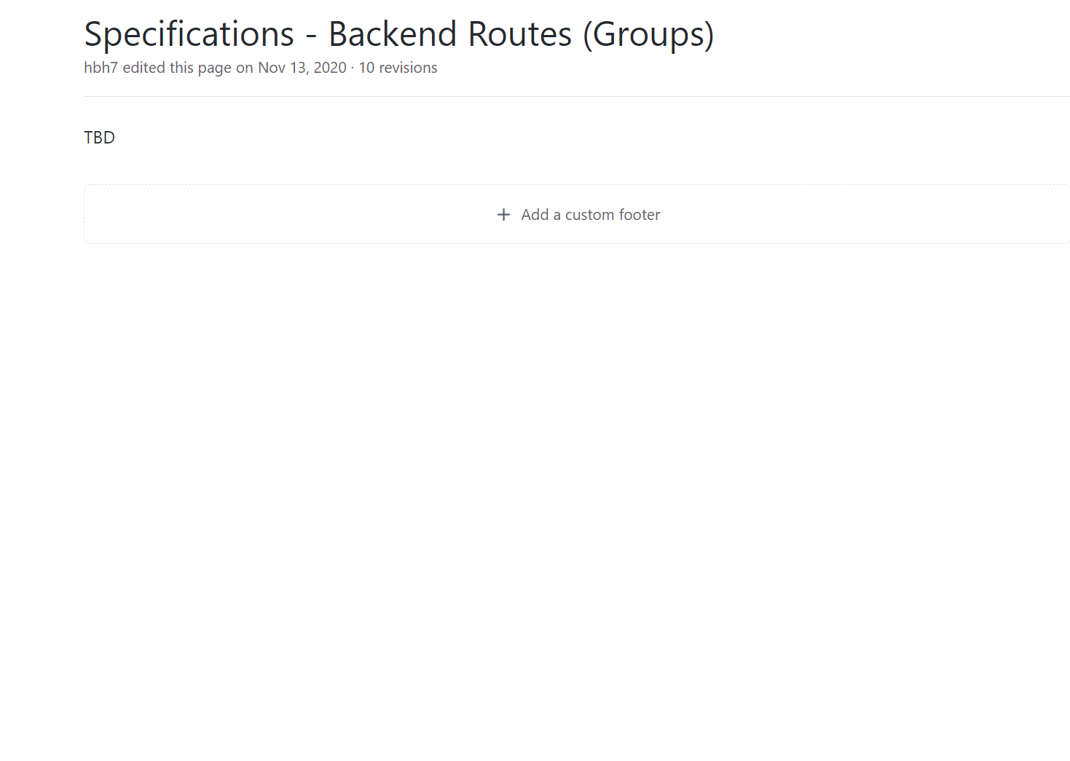
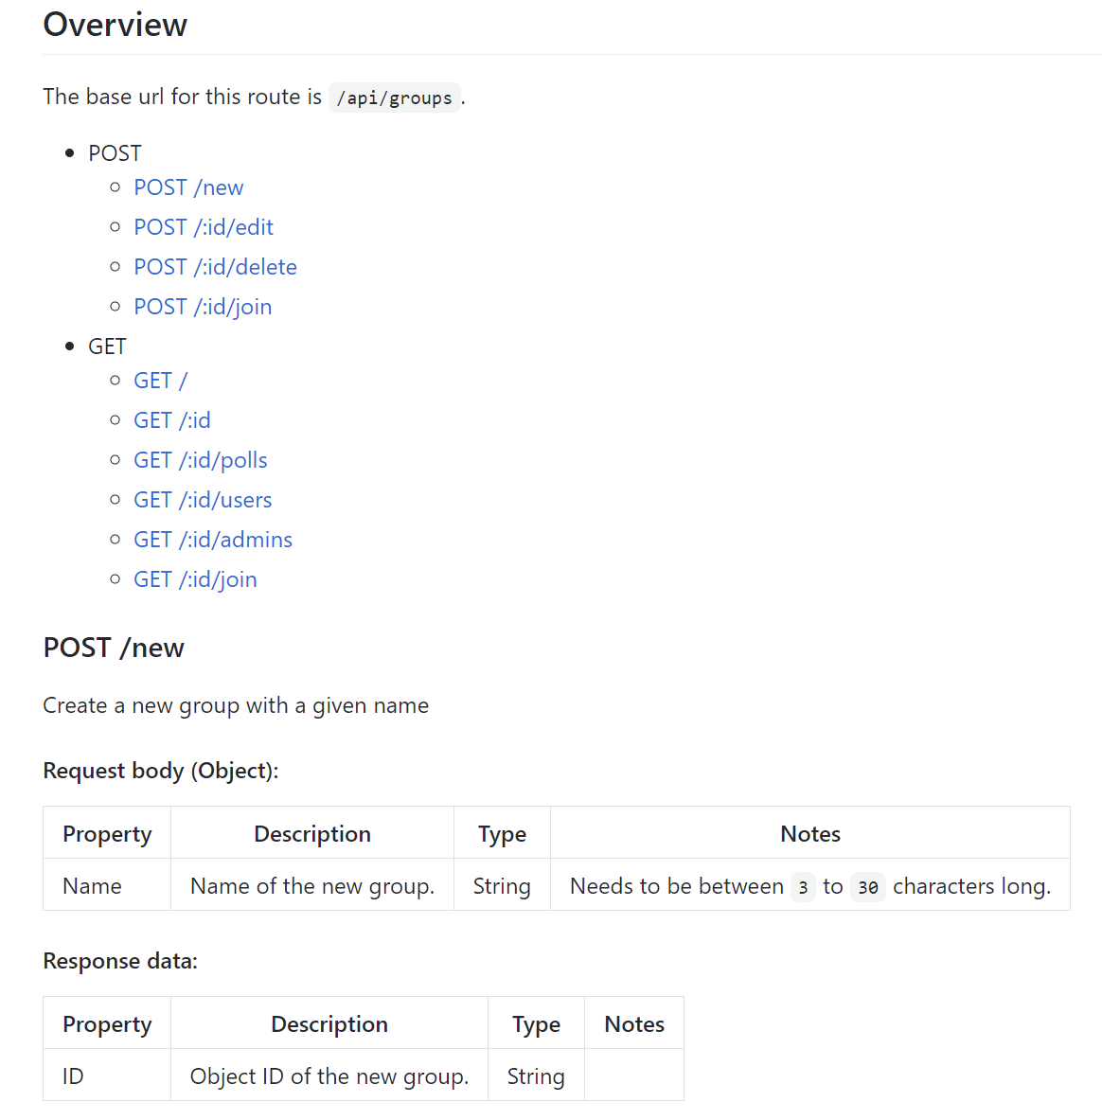
Validation and Documentation
Old Wiki
New Wiki
to
And more back-end validation
Notes:
Presenter: Ethan
This semester I mostly worked on doing documentation on the back-end. This included doing the documentation on all of the endpoints relating to groups in the Poll Buddy database and the technologies we use. It used to have nothing in the groups specification wiki, and now it has a bunch of information on how to use each endpoint. Each endpoint also has similar information in JavaDoc style in the code. I also worked on many validation helper functions so we can be certain of the information we are using. I even used these functions when doing the documentation of the group endpoints, adding validation to inputs as I went through it all.

Slide 18
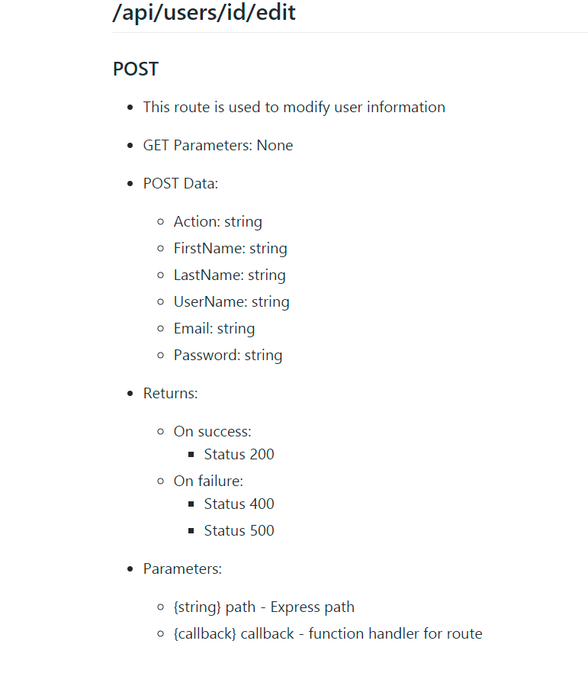
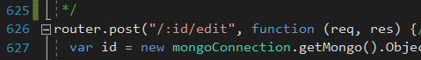
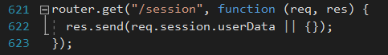
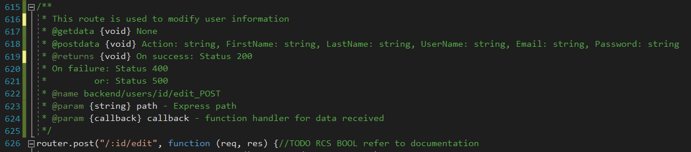
Backend Documentation
Wiki
Function Documentation
Notes:
Presenter: Dani
This semester I spent my time learning JS and contributing to documentation on the back-end. I have focused on adding documentation related to users in the Pollbuddy code and corresponding documentation to the Wiki.

Slide 19
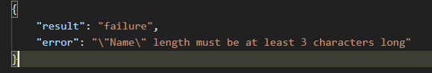
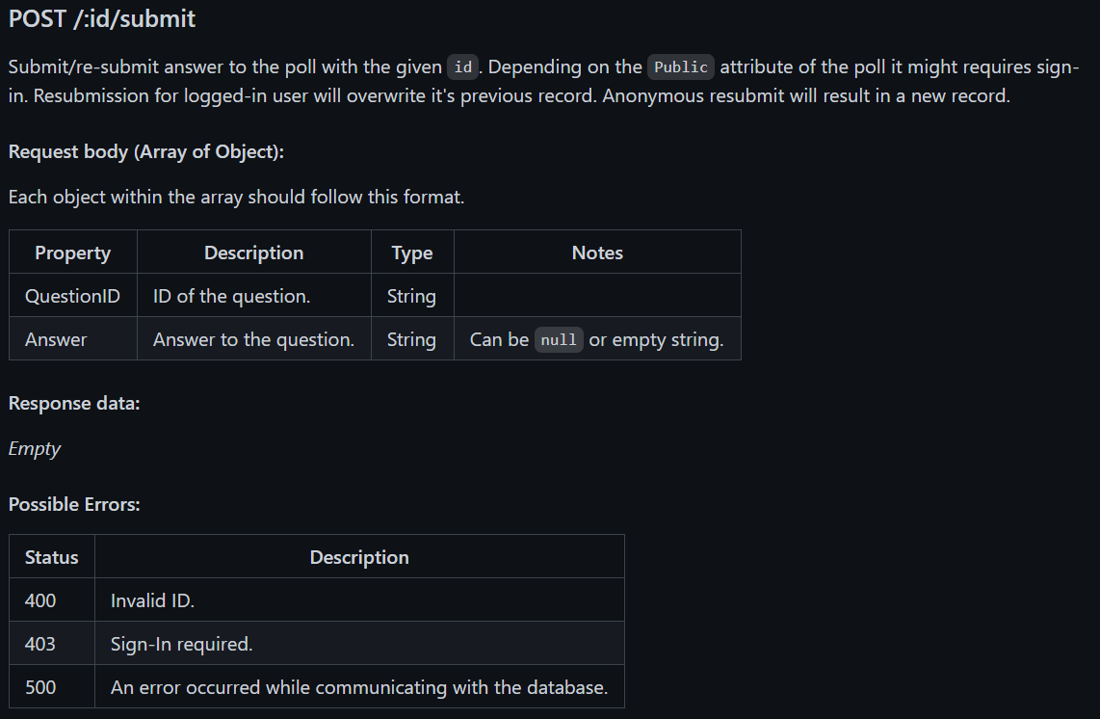
“/polls” route rework
Request body validation
Unified response format
JSDOC style documentation
Wiki documentation
Asynchronous code
Error handling
Make sure code actually works and comply with the decided format.
Middleware and helper functions
Notes:
Presenter: Steven
This semester I focused on renovating several backend routes under the url “/polls”. This includes creating, editing, submitting, and querying polls. The rework is mainly about validating the request body, creating a consistent response format, adding JSDOC comments and wiki documentation on all the routes I worked on. Make asynchronous calls to read the database with error handling, and also some testing to make sure these routes abide to the specification we agreed on. I’ve also created some helper functions and a middleware to help with backend development.

Slide 20

Thank You!
Any Questions?
https://pollbuddy.app/polls/607e502721601577468b4ba8/results
Notes:
Presenter: Hunter
This has been Poll Buddy! I left a link here to the results from the demo poll that people hopefully checked out. But other than that, does anyone have any questions?

